Slide 1
RETHINKING FURTHER PROFESSIONAL EDUCATION: SEARCH FOR MULTIDISCIPLINARY AND NEW TECHNOLOGICAL APPROACHES
Valentina V. Gerasimenko (Russia),
Tatiana O. Razumova (Russia),
Vladimir J. Echenike (Russia)
3.03.2015

Slide 2
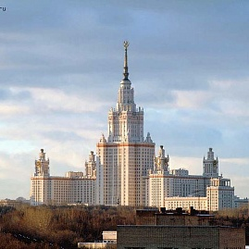

Slide 3
Moscow State Lomonosov University
The oldest and the biggest university in Russia
All stages of economic education:
bachelor, master, PhD,
further education, including MBA

Slide 4
Overview
Research:
Comparative analysis of the results of modern studies and expert estimations of the content and trends of development of the further professional education in the form of MBA programs in Western European and Russian Universities.
Outcome:
The changes of consumers’ choice, innovational educational technologies and actual labour market require development of forms and methods of different programs of further professional education

Slide 5
Modern economic education system
Nowadays economic education in the whole world does exist in the form of the multilevel system including bachelors’, masters’, post-graduates’ programs.
Further professional education is an important and specific part of this system. Almost every large university or business school in Russia and abroad offers special programs of further professional education.
These programs are addressed to those grown-ups who have already got tertiary education but are interested in additional knowledge and skills in the sphere of economics and management.

Slide 6
theory of human capital
signaling/screening theory
Theoretical basis for the growing interest to the further professional education

Slide 7
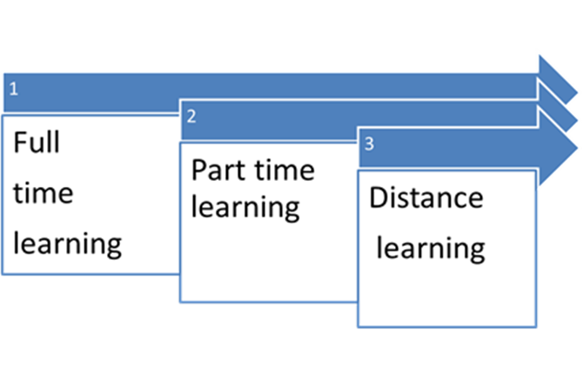
Three main trends
Trend 1: Development of the forms of education from full-time and part-time to distant and module programs

Slide 8
Trend 2:
Development of international standards, quality improvement, globalization of education.
Several stages can be defined if we analyze the changes in further professional education in Russia and particularly in Moscow State Lomonosov University (MSU) during the last twenty years.

Slide 9
Stages of development of further professional education in Russia
adoption of the standards of classical programs (i.e. General MBA) from well-known foreign universities
accumulating the original experience and elaboration of the system of accreditation , engagement of foreign professors and lecturers
preparing of the special original programs, adoption the procedures of international approbation and accreditation of these programs
partnership of the universities from different countries in outlining of special modules of further professional education programs
development of the partnership of the universities from different countries in launching double-diploma programs

Slide 10
Trend 3:
Transition from the content of classical universal programs of General MBAs toward the interdisciplinary MBA programs based on the intersection of economics, sociology and psychology.
New approaches to business communications, organizational behavior, economics and network partnerships, etc.

Slide 11
Empirical research
The study was conducted by interviewing graduates of MBA programs of economic faculty of Moscow State University, provided in Russia and Kazakhstan.
Totally 286 respondents participated in the survey.
For the purpose of comparability with the results of other European studies the technique of interviewing applied in a number of universities and business schools in Germany was used.

Slide 12
Competencies from the “Universum Professional Survey” (our partner university in Germany)
 | Competencies | %
1 | Ability to communicate | 52,6
2 | Ability to practical oriented thinking | 48,6
3 | Analytical capacity | 33,1
4 | Ability to work in a team | 32,6
5 | Ability to resolve conflicts | 30,9
6 | Ability to act independently | 30,3
7 | Ability to feel empathy | 29,7
8 | Ability to accept criticism | 27,4
9 | Capacity on time-management | 27,4

Slide 13
Generic competencies for managers
 | Competencies
1 | Ability to apply knowledge in practical situations
2 | Ability to identify, pose and resolve problems
3 | Ability to make reasoned decisions
4 | Knowledge and understanding to the subject area and understanding of the profession
5 | Ability to focus on results
6 | Capacity to learn and stay up-to-date with learning
7 | Ability to search for, process and analyze information from a variety of sources
8 | Ability to work in a team
9 | Ability to plan and manage time

Slide 14
Most valuable results obtained by the German, Kazakh and Russian alumni of MBA programs

Slide 15
Skills and competences acquired through additional education (self estimation of MBAs alumni, %)
 |  | German university,% | Faculty of Economics of MSU, %
1 | Ability to communicate | 52,6 | 58,3
2 | Ability to practical oriented thinking | 48,6 | 66,7
3 | Analytical capacity | 33,1 | 37,5
4 | Ability to work in a team | 32,6 | 50,0
5 | Ability to resolve conflicts | 30,3 | 50,0

Slide 16
CONCLUSION 1: Economic education moves out of limits of strictly economic knowledge and management theory.
One of the main modern tendencies is multidisciplinary interaction which leads to acquiring new innovational result.
The goal of further studies is testing multidisciplinary development trends of further professional education content at universities.
Multidisciplinary interaction is in progress in several ways.
Humanization of knowledge,
increase of social norms and personal character priority, importance of communication activity,
openness,
ethic principles and involvement,
significance of social activity and moral values

Slide 17
CONCLUSION 2: market and business networking
Understanding of the market and business network organization is another important competency that can be acquired through education.
It requires research of modern network interaction technologies.
One of significant goals of further professional education is providing management education to students based on examination of network economy.
This sector will be the subject of research and analysis in future.

Slide 18
Thanks for your attention!

