Slide 1

Marcin Dembowski
How to get published with internationl journals
– publisher point of view.
Moscow
November 2014

Slide 2
Agenda for the session
About OUP
Products ...
To ‘demystify’ the publishing process
To provide tips, insider knowledge and key questions to maximize your chances of publication
Q&A session: ask anything!
Follow-up: I’m always available to help
To get you sharing your knowledge, i.e. to get you writing

Slide 3
Oxford University Press

Slide 4

Oxford University Press (OUP)
Our mission
Oxford University Press is a department of the University of Oxford. It furthers the University's objective of excellence in research, scholarship, and education by publishing worldwide.
John Fell
Clarendon Presentation—Tim Barton (November 2011)

Slide 5

Digital publishing
Across multiple sectors: Law, Medicine, Reference, Academic, Trade, Journals, Dictionaries…
40 + online products
Multiple data types and data models
One very simple data strategy: XML
Notes:
GAB publishes a huge variety of content.
We already have more than 30 online products, the first being published over 10 years ago now
There is a multitude of data types and data models because of all those different sectors and different content – law reports, books, reference books, journal – they’re all slightly different in the way they’re structured.
We therefore have one very simple data strategy – XML: Get all content into XML and then output into whatever format we want it to be in.

Slide 6
We support each stage of higher education
Supporting students education – high level of subject overviews in Oxford Textbooks, Oxford Handbooks online and monograph published in University Press Scholarship Online
Supporting researchers – Oxford Journals and Archives
Supporting publishing possibilities – large varieties of products

Slide 7




Presentation Outline
Online Dictionaries

Slide 8
Oxford Journals
Supporting Researchers and Research Communities

Slide 9
2014 Oxford Journals Collection
  Over 300 titles, over 25 titles to be added in 2015
  Access to content dating back to 1996
  Impressive online functionality with HighWire Press

Slide 10
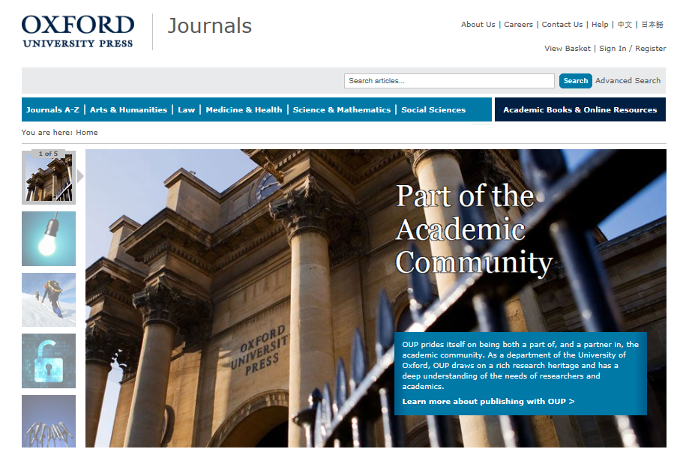

Oxford Journals

Slide 11
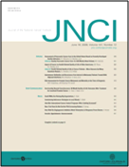
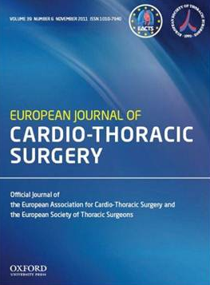
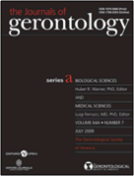
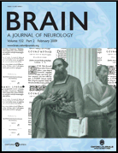



The Medicine Collection
  Oncology, cardiology, neurology, epidemiology, reproductive medicine, rheumatology, anesthesia, gerontology, & public health
The Life Sciences Collection
  Molecular and computational biology, plant science, marine biology, and behavioral ecology

Slide 12
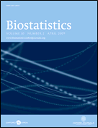
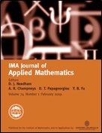


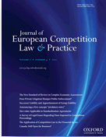

The Mathematical & Physical Sciences Collection
Pure and applied mathematics, radiation science
Also coverage of more niche areas such as biostatistics and mathematical physics, management, and medicine
The Law Collection
general academic and practitioner law titles, and those dedicated to more specialized areas such as medical & environmental law, criminology, intellectual property, & policing

Slide 13
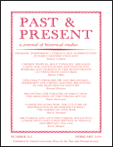
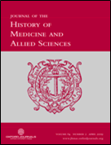
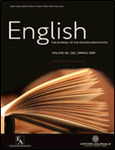
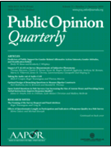

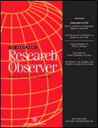
The Humanities Collection
  History, philosophy, literature, religion, art, and music
The Social Sciences Collection
  Economics, finance, business, global development, religion, and social politics

Slide 14
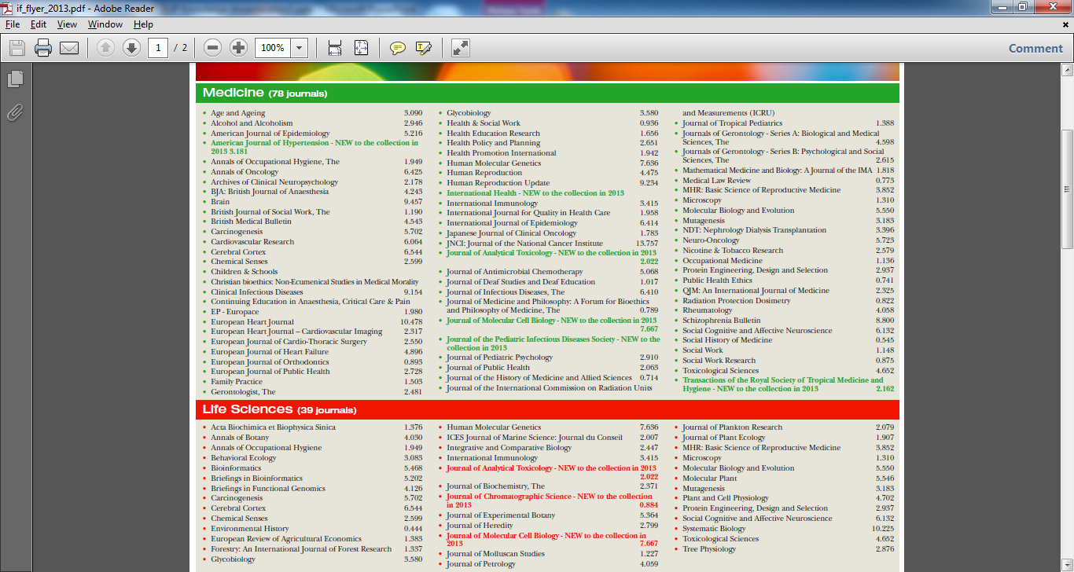

Slide 15
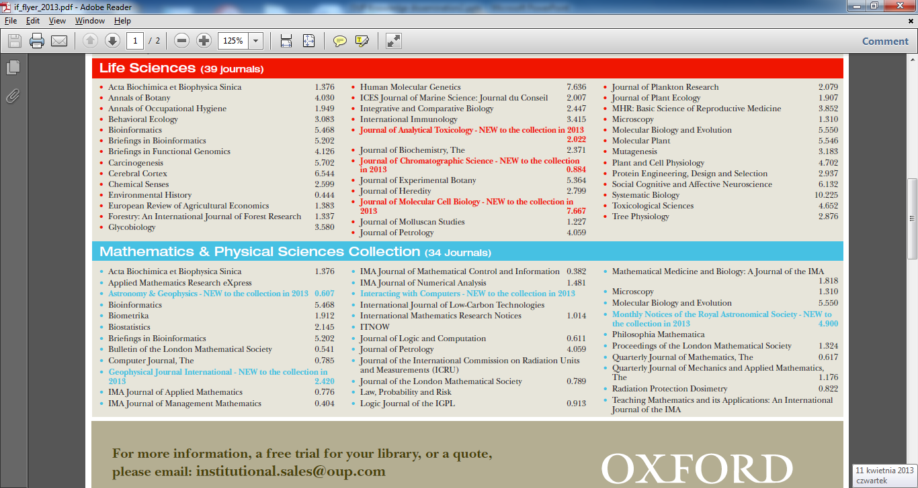

Slide 16
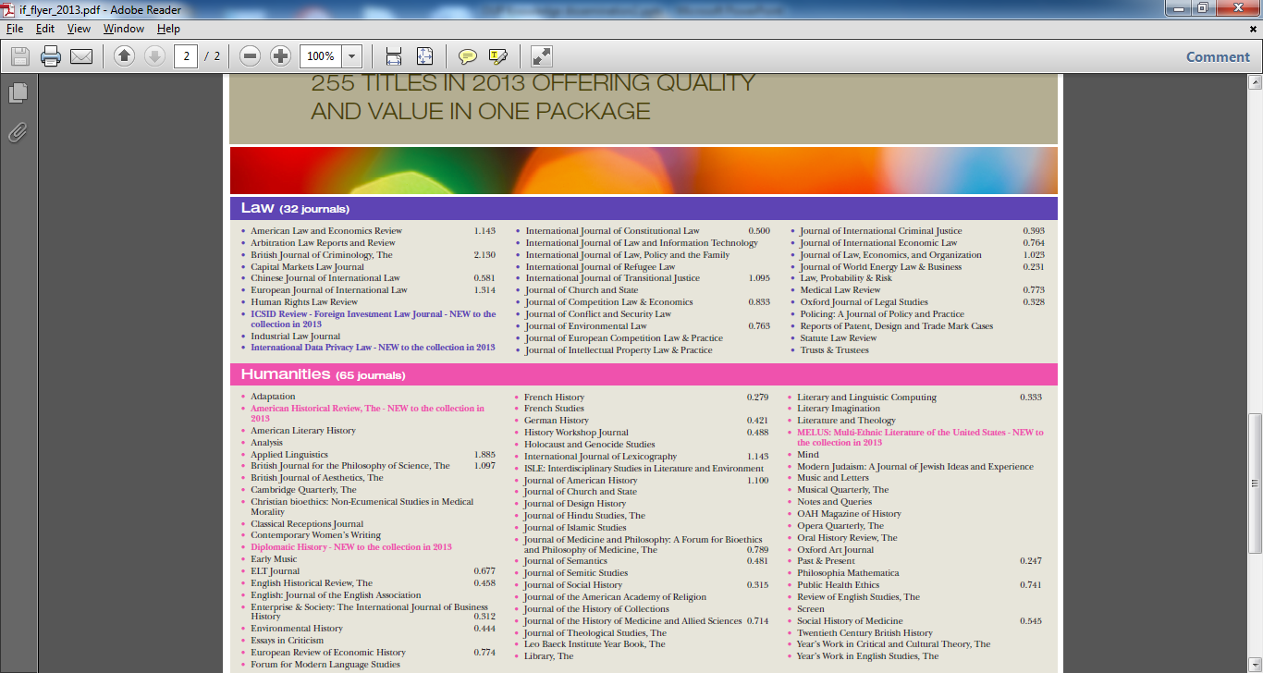

Slide 17
Oxford Handbooks Online
Leading scholars / Cutting-edge research reviews / Smart digital design

Slide 18
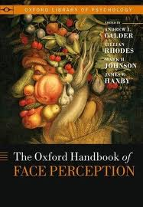
Oxford Handbooks Online:
History of the Oxford Handbooks
Publishing started in 2003
~200 in print
Current state of scholarly debate
Combines synthesis with original argument about future directions
Perspective, Review, Original Argument

Slide 19
Oxford Handbooks Online
Archaeology
Business & Management
Classics
Criminology
Economics & Finance
History
Law
Linguistics
Literature
Music
Philosophy
Political Science
Psychology
Religion
Over 10 000 Chapters

Slide 20





Oxford Handbook Series
Print Program
What is an Oxford Handbook?
Definitive collection of essays on a subject
Why create a special site for the Handbooks?
One of OUP’s most successful book series
Huge publishing program: 296 in print, 450 in the pipeline
Why are these books so popular?
Review essay essential in age of specialization & info overload
Chapters review of current state of debate
Notes:
What is the purpose of the HB?
Advance original conception of the field through definitive collection
Each essay a review of the current state of debate on key topic
Successful series by any measure
10 Years and running
Excellent sales
Titles regularly reviewed
TLS: “major contribution to the debates about animals by giving the philosophical basis for many of the current views”
Huge program: 14 disciplines; 700+ books under contract; +10k published chaps (c25,000 in all)
Review essays have special role to play
Increasingly important in age of specialization and cross-disciplinary
We see them widely read and cited in the journal world – highest impact factors
Saves time
Sophisticated form of academic writing that helps researchers get up to speed on a topic.
Print success does not automatically ensure digital success
Rethinking the way we deliver this material online to better match changing research behaviors
Ensure wide dissemination and use

Slide 21



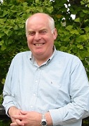









Editors in Chief and Editorial Boards
Chris Gosden Archaeology | Michael Hitt Business and Management | Michael Tonry Criminology and Criminal Justice | William Doyle History
Sally Thomason Linguistics | Colin Burrow Literature | Alexander Rehding Music | Sandy Goldberg Philosophy
Desmond King Political Science | Peter Nathan Psychology | Mark Juergensmeyer Religion | Markus Dubber Law
Gareth Williams
Classical Studies
Ensure accuracy, authority, and objectivity
Commissioning online-only peer reviewed articles
Expanding research in cutting edge topics
Ensuring comprehensive coverage of fast-moving disciplines

Slide 22
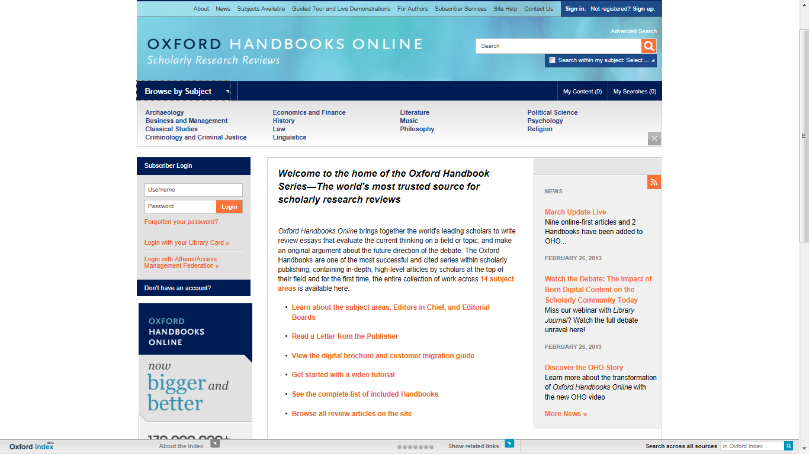

Slide 23
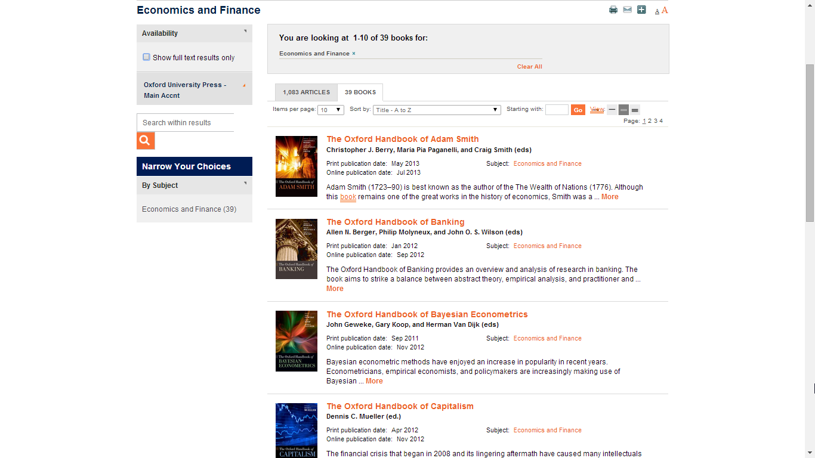
Economics and Finance - Oxford Handbooks

Slide 24
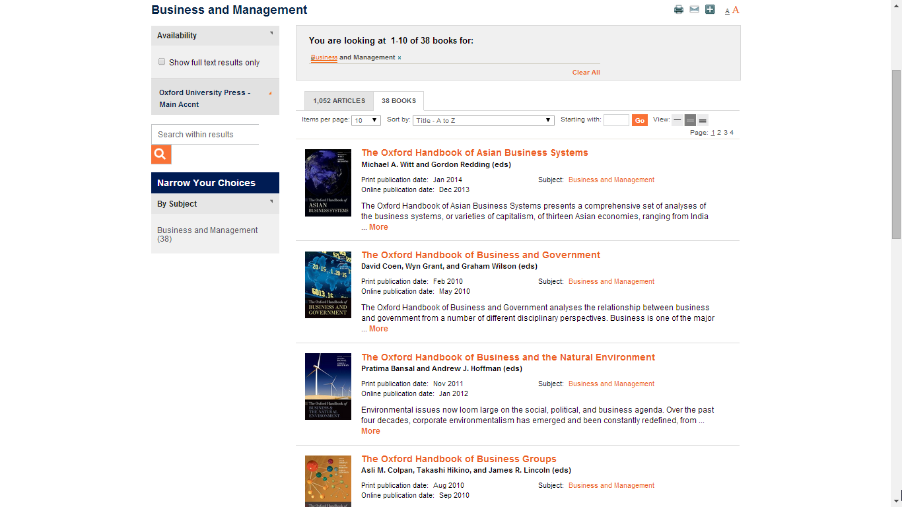
Business and Management - Oxford Handbooks

Slide 25
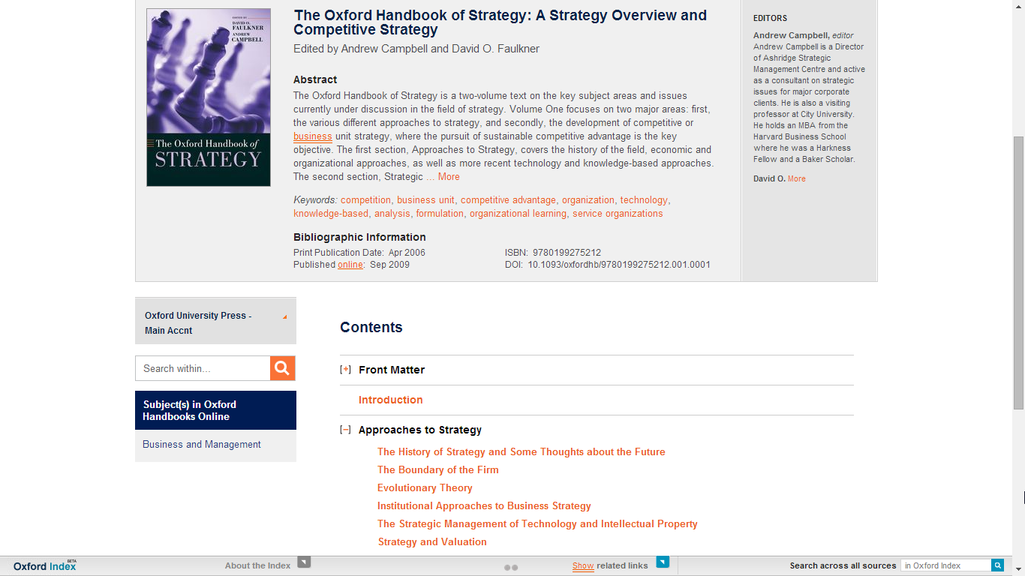
Oxford Handbook of Strategy - Oxford Handbooks

Slide 26
Oxford Scholarship Products
Supporting Researchers and Research Communities

Slide 27


Presentation Outline
Oxford Scholarship Online
University Press Scholatship Online
Notes:
This presentation introduces the history of one of our flagship online products – Oxford Scholarship Online and uses it as a case study to take you behind the scenes when creating and digitising an online product, from the publisher perspective.
It also offers up three key challenges that we meet when digitizing our academic monographs.
There will be opportunity at the end of the presentation to reflect on the challenges and discuss the future of ebooks, but if you have any questions in the meantime, or you need me to explain anything further, or slow down, please do speak out.

Slide 28
Presentation Outline
Oxford Scholarship Online
University Press Scholatship Online
10,000 Books in 20 discilplines
15,000 Books in 28 discilplines
Notes:
This presentation introduces the history of one of our flagship online products – Oxford Scholarship Online and uses it as a case study to take you behind the scenes when creating and digitising an online product, from the publisher perspective.
It also offers up three key challenges that we meet when digitizing our academic monographs.
There will be opportunity at the end of the presentation to reflect on the challenges and discuss the future of ebooks, but if you have any questions in the meantime, or you need me to explain anything further, or slow down, please do speak out.

Slide 29
University Press Scholarship Online (UPSO)
Participating presses:
Oxford University Press The American University in Cairo Press
University of Chicago Press University of California Press
Edinburgh University Press University Press of Florida
Fordham University Press Hong Kong University Press
The University Press of Kentucky Manchester University Press
Policy Press The MIT Press
Stanford University Press

Slide 30
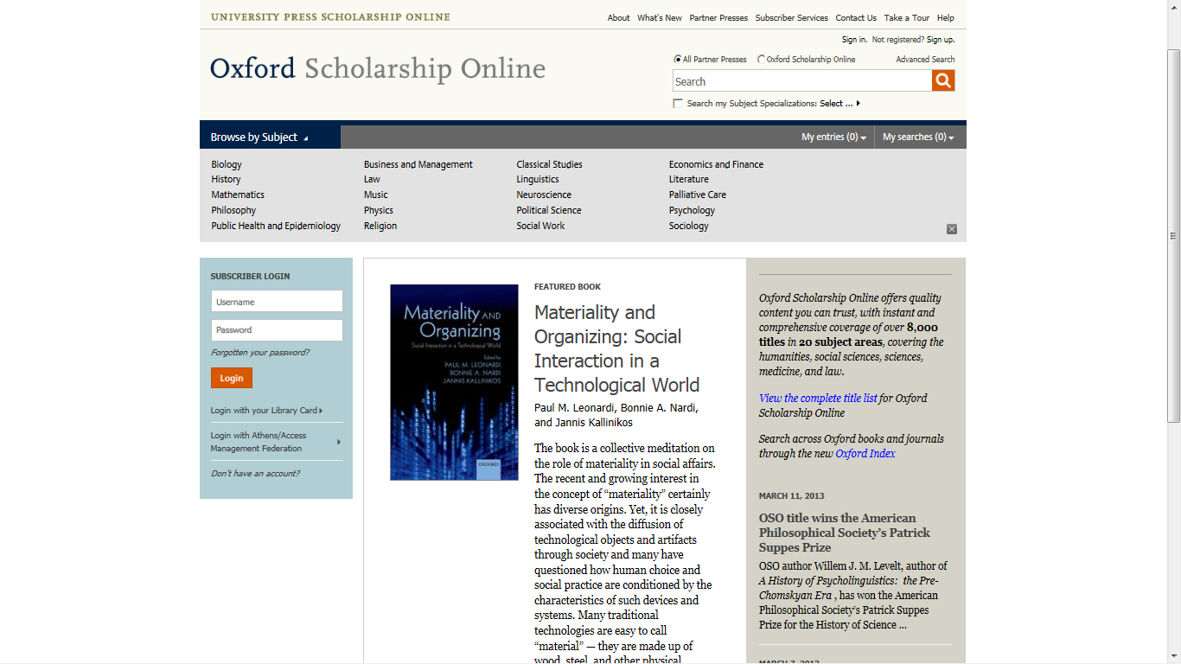

Slide 31
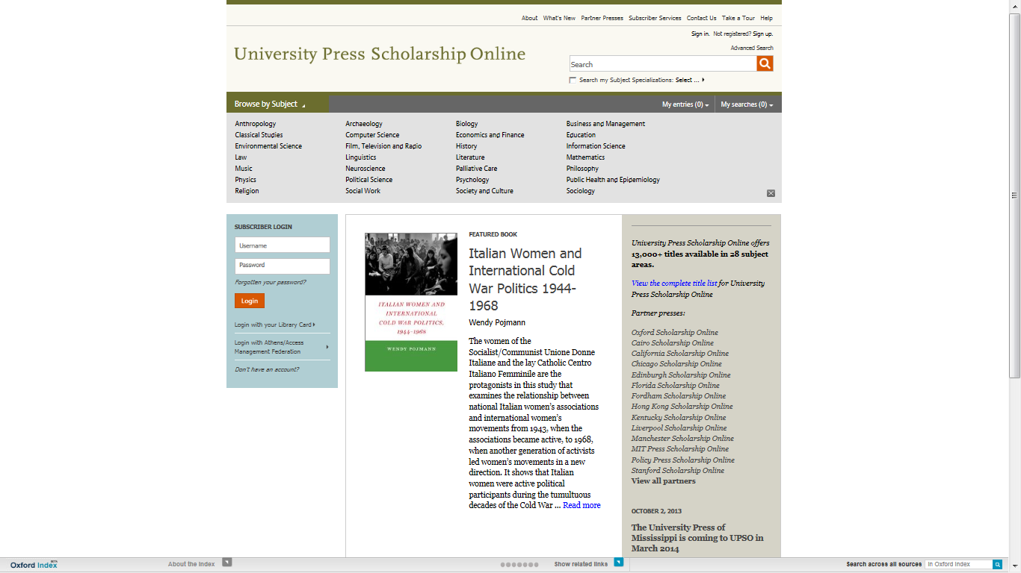

Slide 32
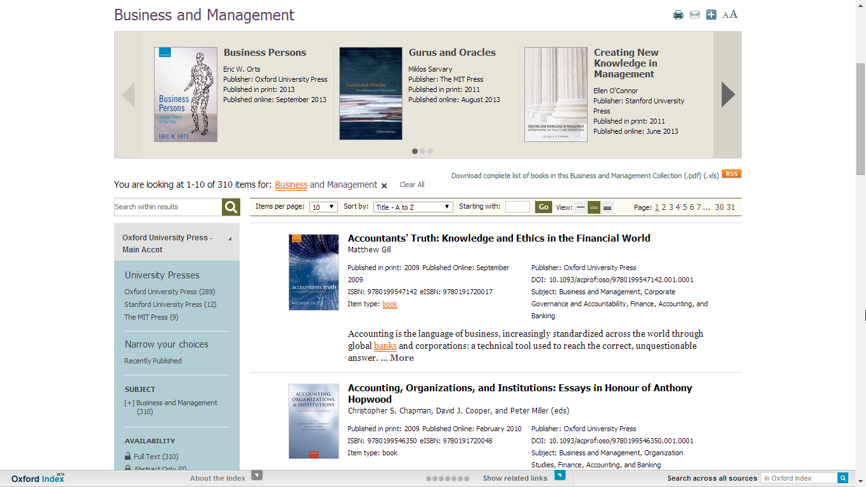
Business and Management - University Press Scholarship

Slide 33
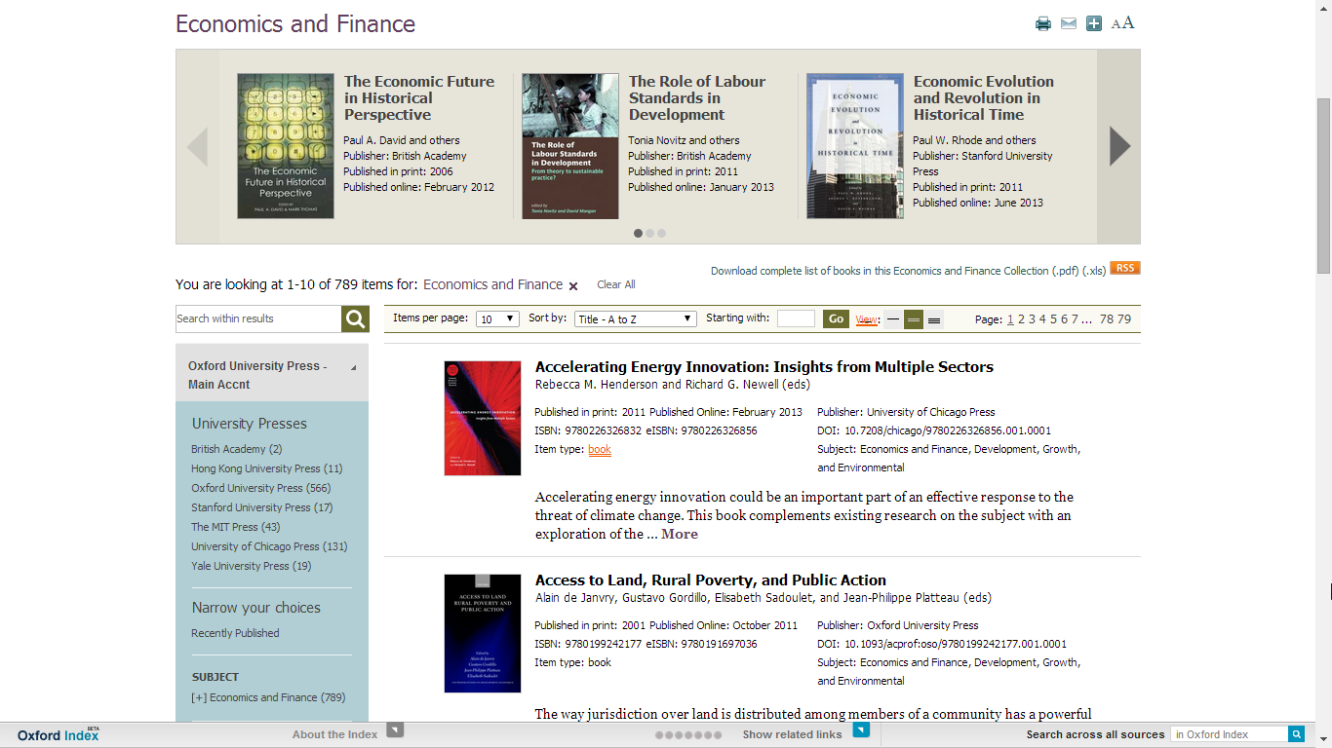
Economics and Finance - University Press Scholarship

Slide 34

Very Short Introductions (VSI) Online

Slide 35
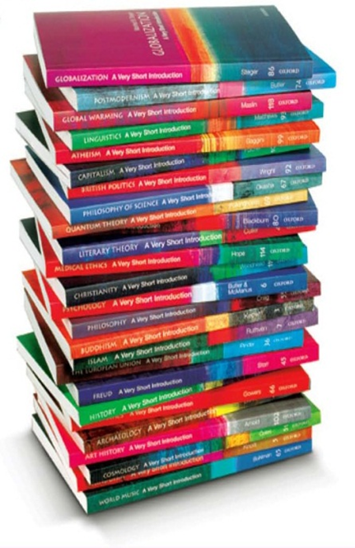
What is a VSI?
Established in 1995, now over 300 titles
One of the best recognized cover designs in the world
Make often challenging topics highly readable
A bridge between reference content and higher academic work
Appeal to students, professionals, academics, and anyone who wants an intellectually stimulating read
Range from 96–224 pages, most between 120–180
Publish 40–45 titles a year
Sold over 1.4m units in UK, Europe, Asia-Pac in six years

Slide 36
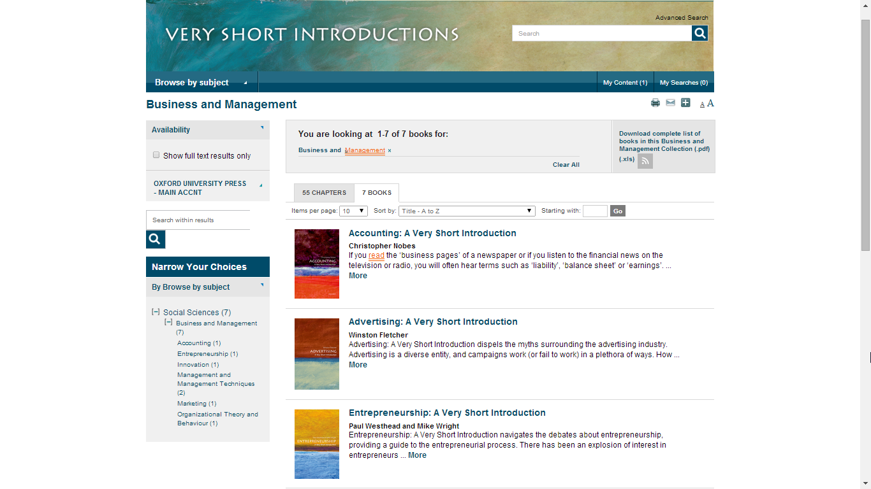
Business and Management - Very Short Introductions

Slide 37

Oxford Bibliographies Online – Management

Slide 38
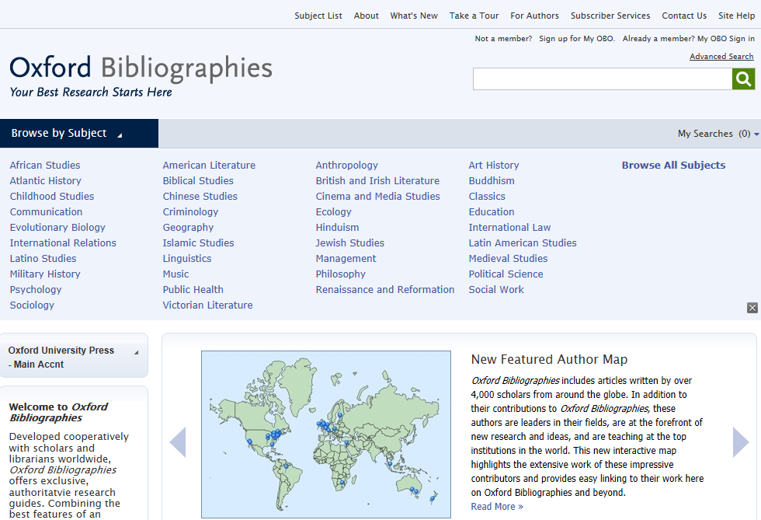
Oxford Bibliographies provide selective bibliographic research guides offering expert recommendations on the best works available in a given discipline.
Developed cooperatively with scholars and librarians worldwide they combine the best features of an annotated bibliography and a high-level encyclopedia.

Slide 40
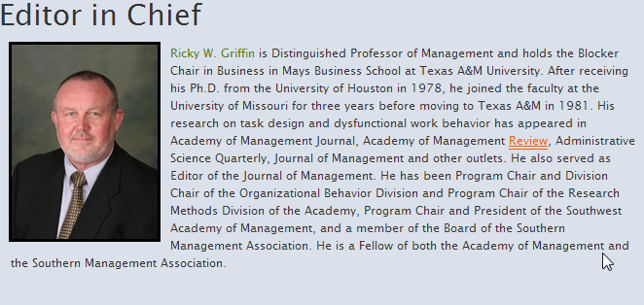
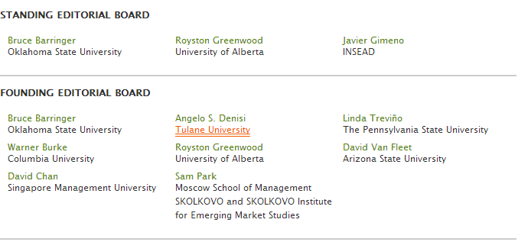
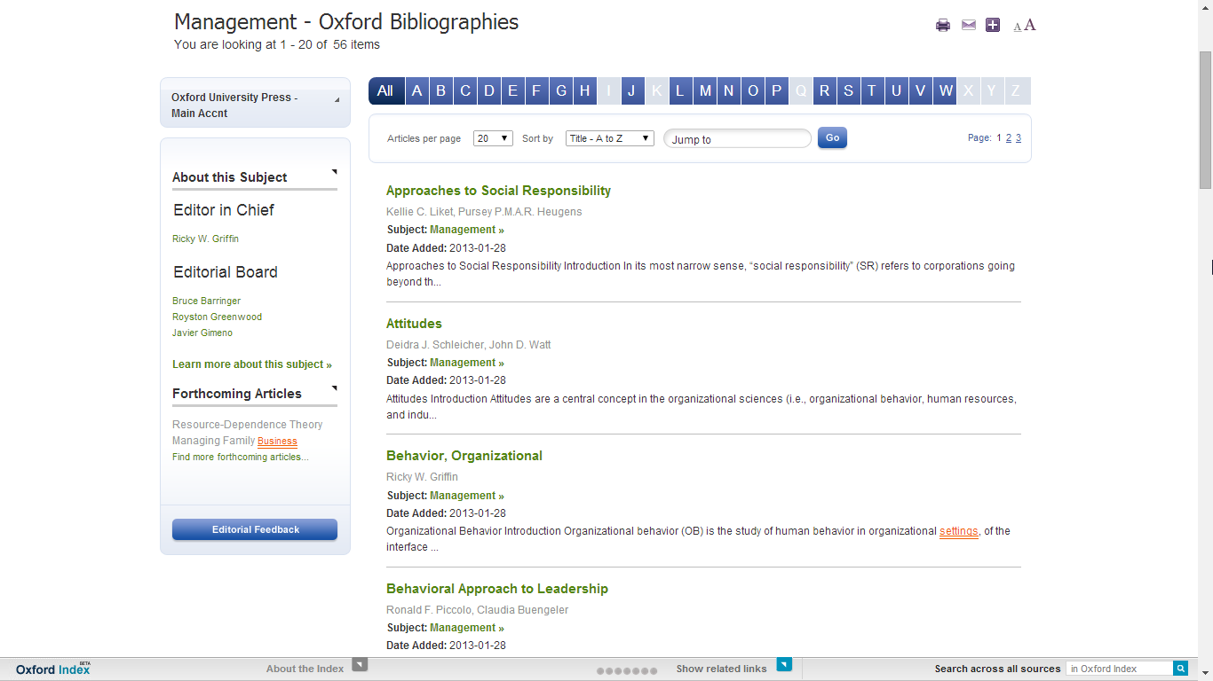
Management - Oxford Bibliographies
Every subject area is overseen by an
Editor in Chief, an Editorial Board, and peer reviewers, ensuring a balanced perspective and scholarly accuracy and objectivity.

Slide 41
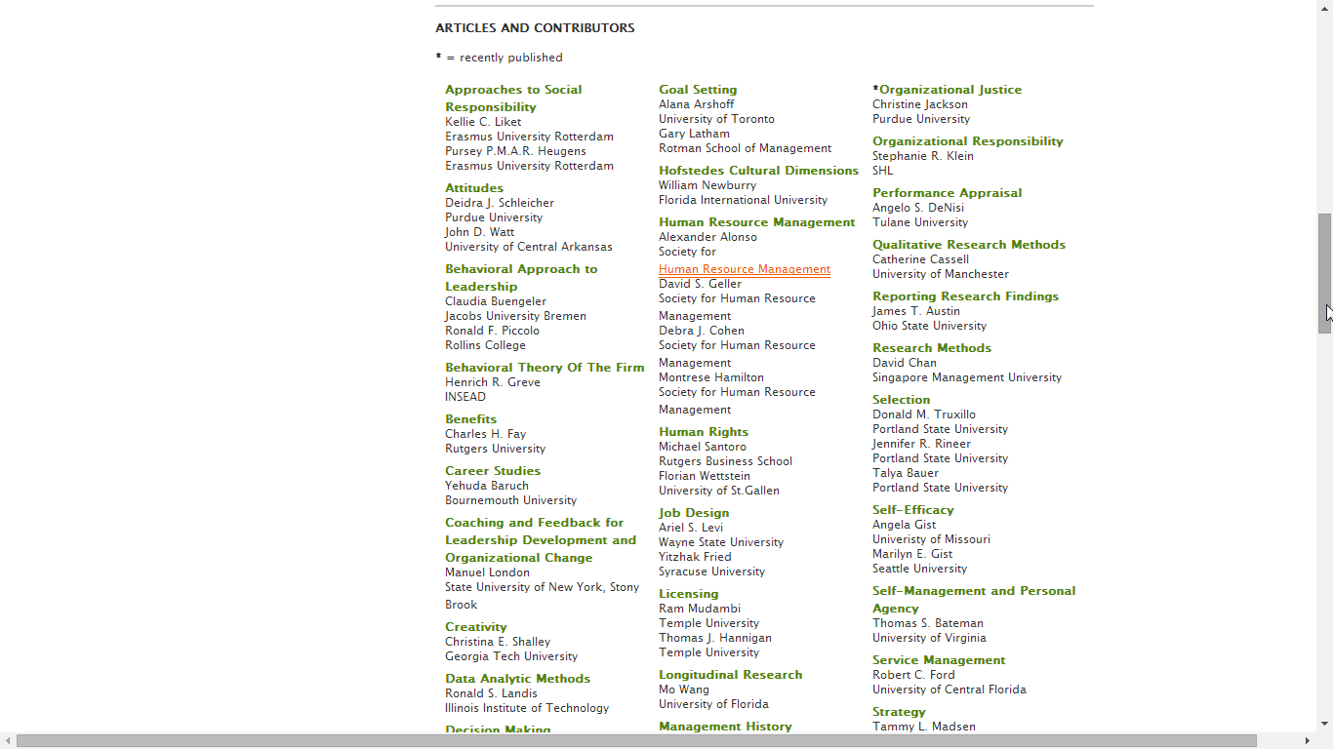
Articles and Contributors

Slide 42
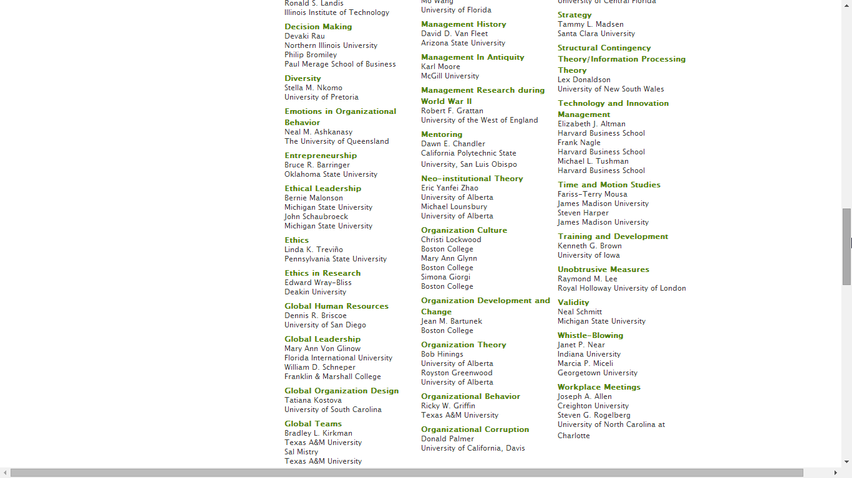
Articles and Contributors

Slide 43
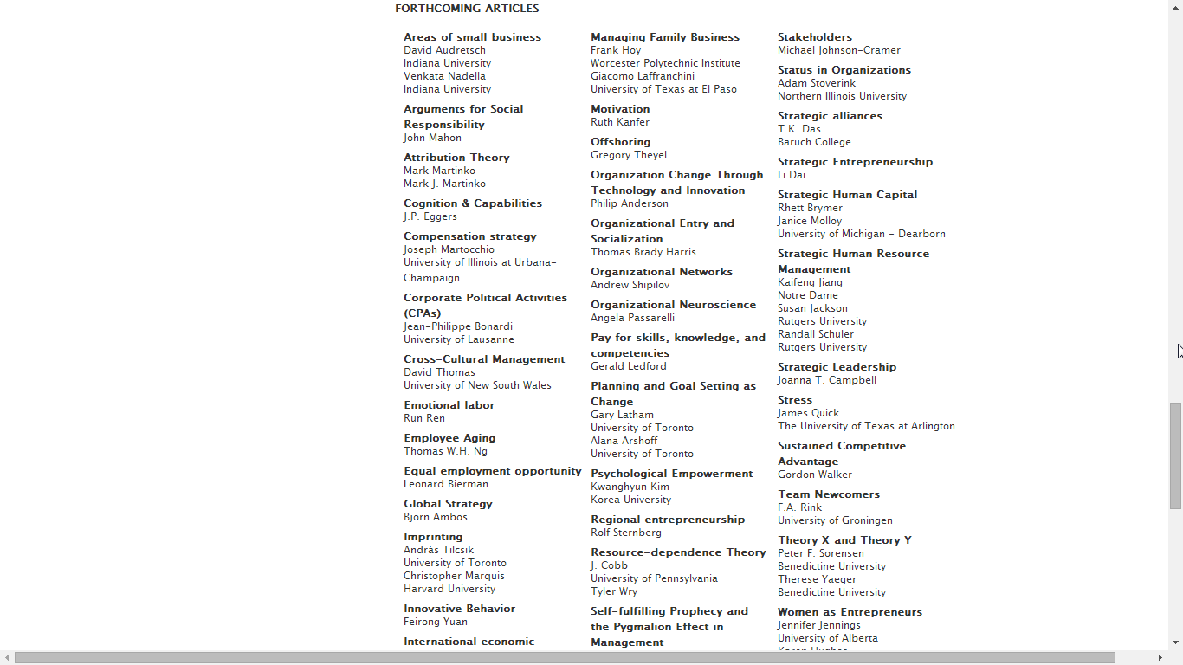
Forthcoming Articles

Slide 44
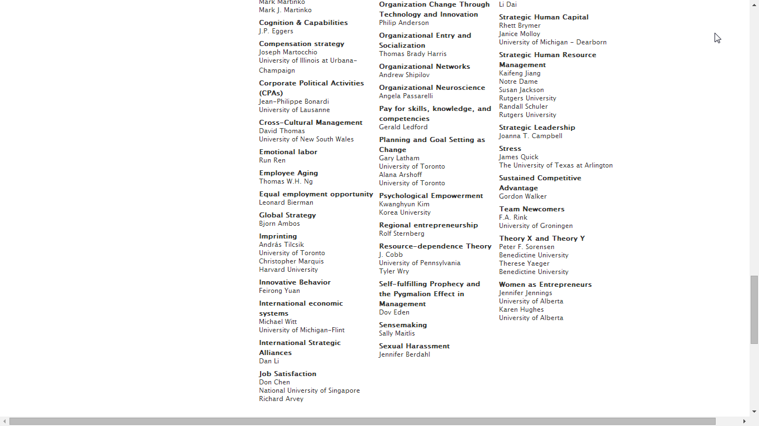
Forthcoming Articles

Slide 45
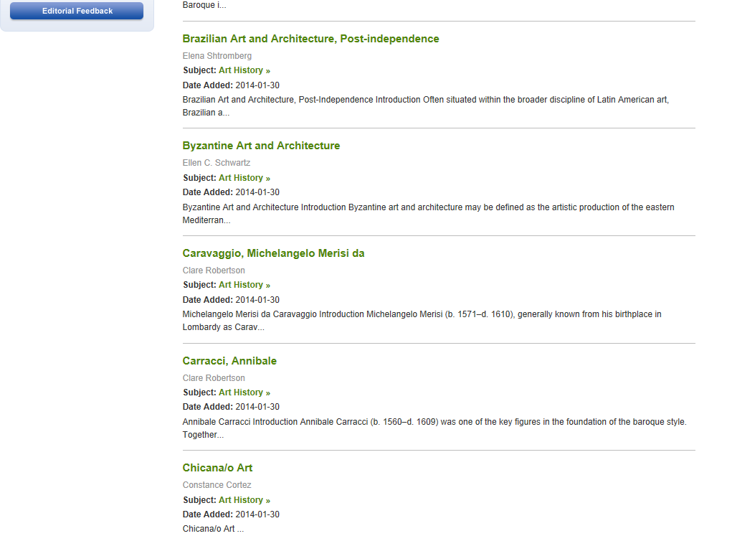
Select the article

Slide 46
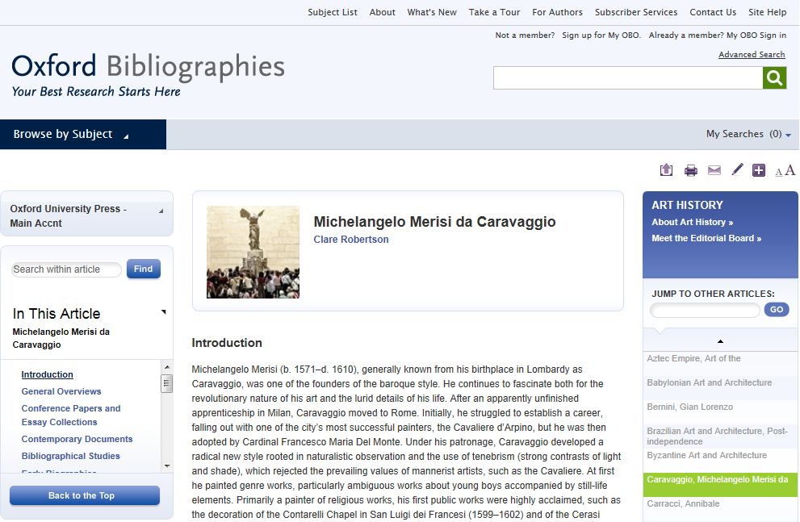
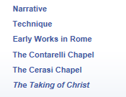
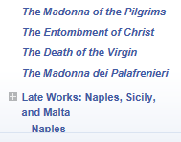
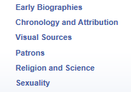

Each article, with an introduction written by a top scholar in the fields, is an authoritative guide to the current scholarship with commentary and annotations.

Slide 47
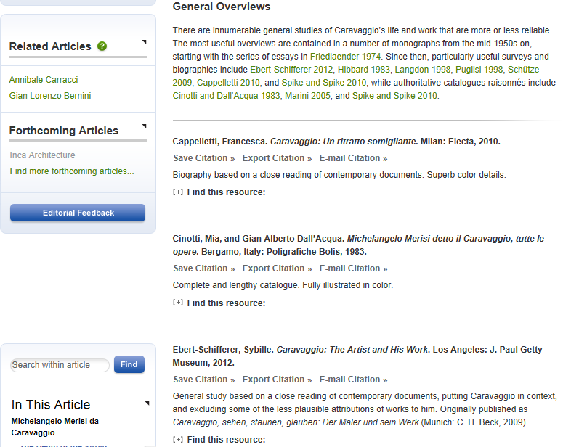
Narrative pathways through the key literature on a topic offer a trustworthy starting point for research

Slide 48
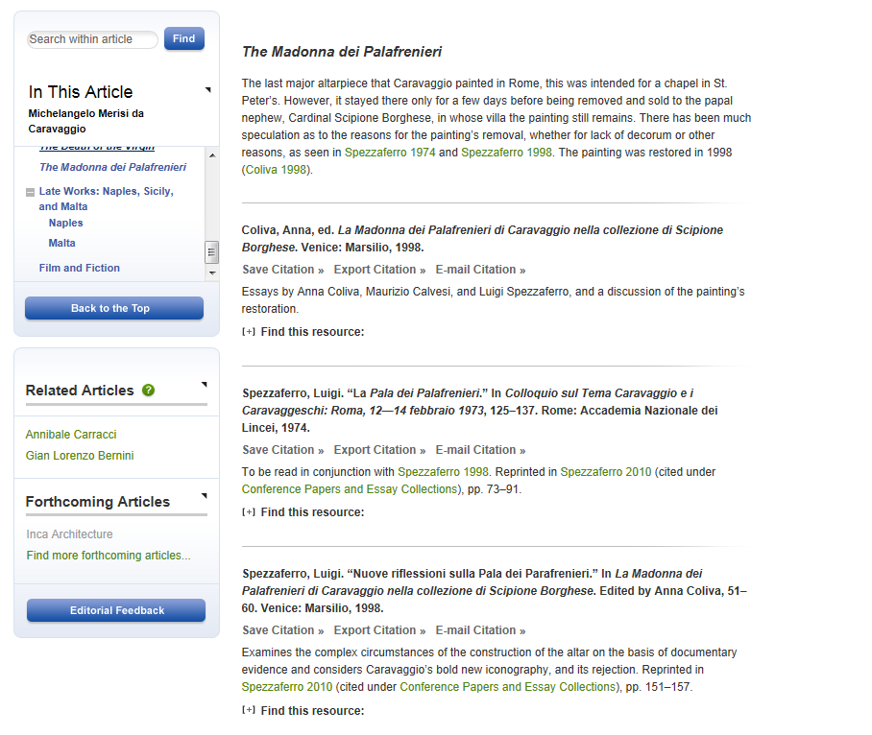

Intuitive linking and discoverability tools help users quickly locate full text content

Slide 49




Oxford’s Specialised Platforms
OXFORD LAW

Slide 50

Discoverability
How to find reliable, authoritative content?

Slide 51

Discoverability
Search across 2.5 million abstracts from Oxford University Press – scholarly essays, journal articles, and reference works
Freely available abstracts make discovery of Oxford’s content via Google and other search engines easier
Overview pages with links to additional resources

Slide 52
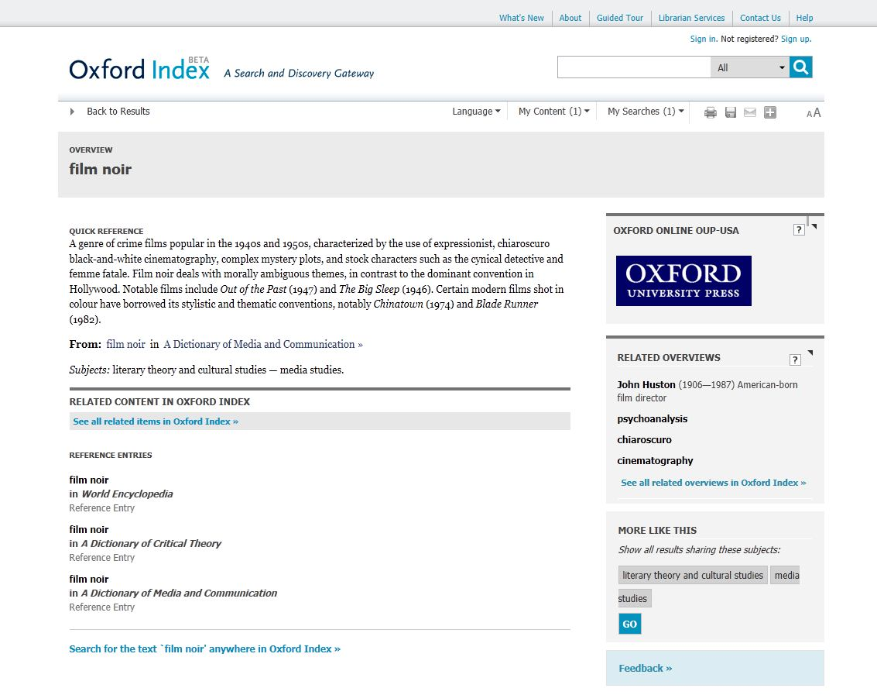
Discoverability
Free searching and content previews
Filters – such as subject or content type
Succinct entries on a single topic
Freely available abstracts
The Oxford Index Underbar generates related content links

Slide 53

The User Journey
Reference, biography, and dictionaries
From quickly checking a fact or definition to researching a term, concept, or person in-depth, with articles and essays
Very Short Introductions
Discover an intelligent and serious introduction to a topic or subject, written by experts in the field that make often challenging topics highly readable
All connected by the Oxford Index
One search brings together top quality content and unlocks connections in a way not previously possible.
Handbooks
Read in-depth, high-level articles by scholars at the top of their field, with each handbook creating an original conception of the field and setting the agenda for new research
Academic monographs
Research-level scholarship providing a written study of a single specialized subject, or an aspect of it

Slide 54
How to get published with international journals?

Slide 55
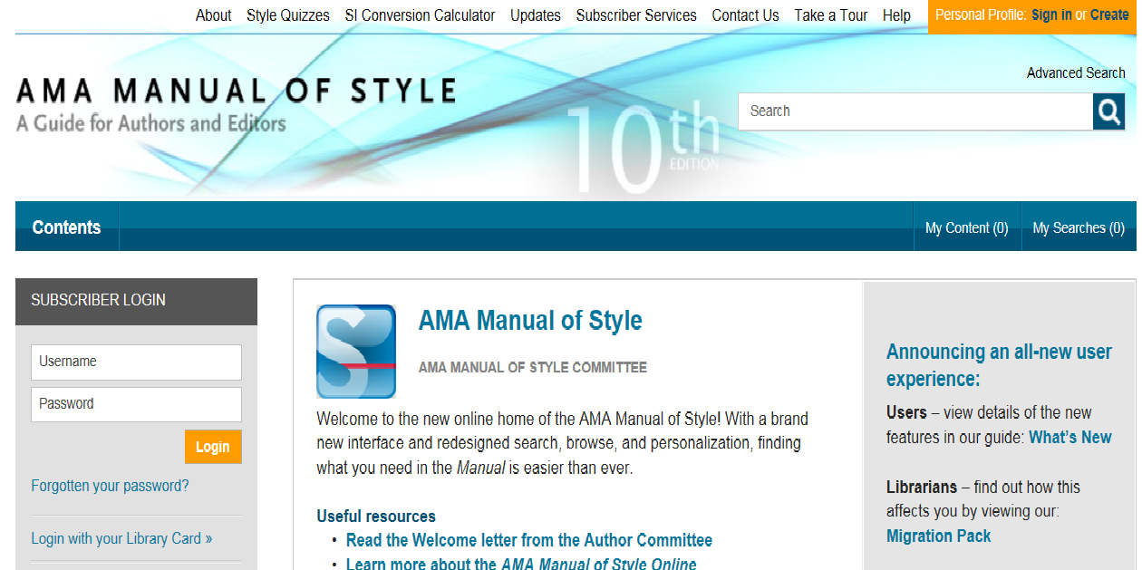
M
AMA Manual of Style

Slide 56
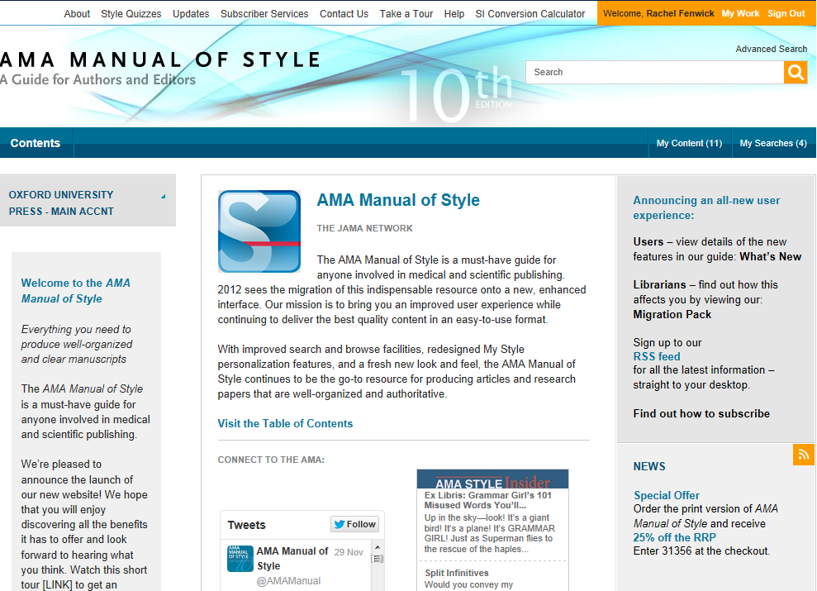
What is the AMA Manual of Style?
A must-have guide for anyone involved in medical or scientific publishing
An essential, one-stop resource providing quick access to authoritative information.
Everything you need to produce well-organized and clear manuscripts

Slide 57
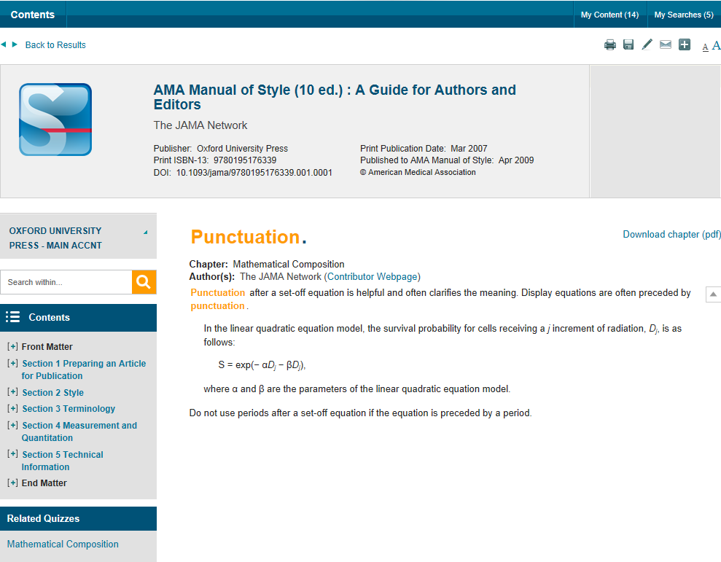


Linking from course packs and reading lists
To add a chapter to an online course pack or reading list, COPY and PASTE the DOI to the end of the standard URL prefix. Eg. 10.1093/jama/9780195176339.001.0001
Students who click on this URL will be taken straight to this section
DOIs are unique and permanent so you don’t need to worry about broken links

Slide 58

Before you start………….
You must have a clear topic
or topics to be reviewed,
what is your research
question?

Slide 59
Ideas where to start
As well as ‘traditional’ research…
Are you working on a Doctoral or Master’s thesis?
Have you completed a project which concluded successfully?
Are you wrestling with a problem with no clear solution?
Do you have an opinion or observation on a subject?
Have you given a presentation or conference paper?
If so, you have the basis for a publishable paper

Slide 60

Editors are looking for “something new and preferably surprising” according to Dr. Peter Smith, a Cambridge philosopher and former editor of Analysis, the philosophical journal.
NEW IDEAS
NEW IDEAS
NEW IDEAS

Slide 61
Be Careful:
There are 1,000,000’s of published studies. You need to MASTER your topic: be aware of works completed by others, updates or/and be ready to answer questions or summarize it.

Slide 62
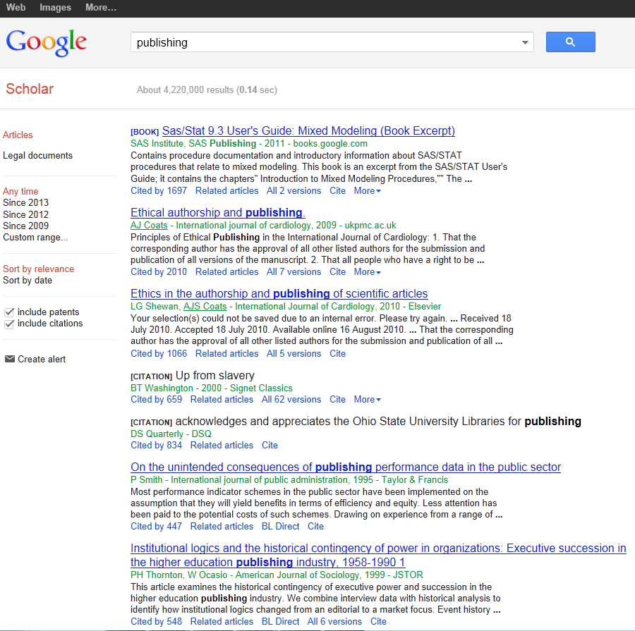
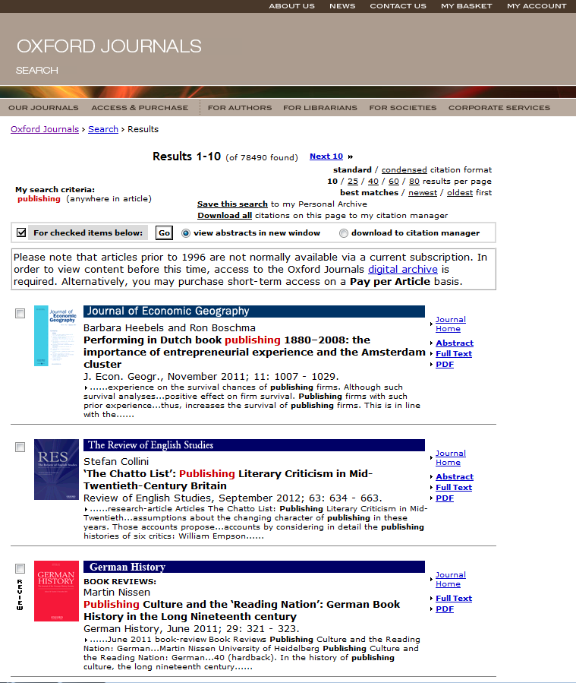
References:

Slide 63
Oxford Bibliographies Online
OBO is a library of discipline-focused, online guides to the essential literature across a broad range of subject areas.
Each OBO article, written and reviewed by top scholars in the field, is rich with citations and annotations, expert recommendations, and narrative pathways through the most useful and important works on the topic in question.
Intuitive linking throughout quickly delivers the user from a citation to full-text content, whether online or available through a library’s catalog.
“We are drowning in information, while starving for wisdom. The world henceforth will be run by synthesizers, people able to put together the right information at the right time, think critically about it, and make important choices wisely.”
— E.O. WILSON
Notes:
Quote from Edward Osborne Wilson Harvard University professor and 2 time winner of the Pulitzer prize.
27 subject areas available; launching 10-12 new subjects each year
Every subject area has an Editor-in-Chief and Editorial Board, and each article receives multiple peer reviews and board vetting
50-100 articles at launch per subject (equivalent to a 4-volume print encyclopedia)
Updated regularly, with 50-75 articles added per year to each subject area. Updates will also include revisions to existing articles.
It is selective, rather than exhaustive; expert recommendations with critical supportive text and annotation are provided to help cut down on time needed for preliminary research
Articles contain recommendations for scholarship at all levels, from encyclopedias and textbooks to journal articles and data sets – whether you’re starting a research paper, studying for qualifying exams, or preparing a syllabus, OBO is the perfect starting place
Includes indexing of non-print material, especially online resources

Slide 64
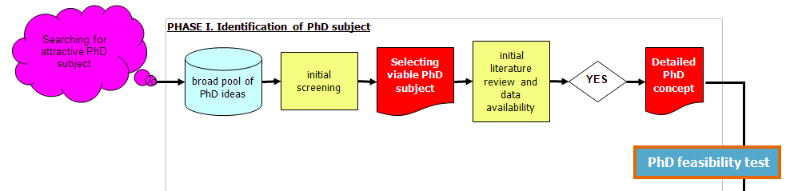
Our Focus

Slide 65
Initial literature review: The 5 X 5 principle
Identify 5 top peer refereed academic journals focusing on
your specific subject
Identify 5 top internationally recognized books or collective
works on your specific subject
Identify 5 top academic research centres specializing in
your subject
Identify 5 most renowned professors in your narrow field
(„gurus”)
Identify 5 top regular international academic conferences
covering your subject

Slide 66

Think of a literature review as a jigsaw puzzle

Slide 67

Which journal to go for?

Slide 68
Criteria You Might Look At:
Rankings (example Thomson Reuters Impact factors; the Association of Business Schools ABS etc.)

Slide 69

OUP Journals
Impact Factor Improvement, 2012

Slide 70
Criteria You Might Look At:
Rankings (example Thomson Reuters Impact factors; the Association of Business Schools ABS etc.)
Number of downloads (utility)
Dissemination of journal (where it is read)
Links to societies/associations
Relevance of content and publishing ethos
International

Slide 71
Questions to Ask Yourself
When Choosing:
What are your most important factors when choosing a journal?
Which resources do you use to research the journals you publish in?
Which rankings do you use? How important are they?
Who do you ask for advice?
What is the best journal in your field? Why?

Slide 72

PROCESS!!!!!
Putting A and B together to build up your work

Slide 73
Surviving peer review
Not always straight forward proccess

Slide 74

Research is all about peer review
You need to avoid a desk reject
You may need to revise and resubmit
You will almost certainly need to alter your paper

Slide 75
The Process
Submission is an important step on the road to being published
Reviewers are selected for their expertise by the Editors
They do sometimes make mistakes and their opinions may not be valid
But generally they raise genuine concerns about the work – conceptualization, execution and/or interpretation of the work

Slide 76
The Process
Their comments are aimed at maintaining the quality of papers publish in the journal, the overall journal reputation and ultimately at improving your work to attain a high standard of academic writing.

Slide 77
Process Conclusion:
Identify a few possible target journals but be realistic
Follow the Author Guidelines: scope, type of paper, word length, references style, etc.
Find where to send your paper (editor, regional editor, subject area editor) …
… and how to send it (email, hard copy, online submission)
Send an outline or abstract to editor: is it suitable? how can it be made so?
Read at least one issue of the journal

Slide 78


Slide 79


Slide 81


Slide 82


Slide 83


Slide 84


Slide 85
What makes a good paper?
HINT: Editors and reviewers look for …
Originality – what’s new about subject, treatment or results?
Relevance to and extension of existing knowledge
Research methodology – are conclusions valid and objective?
Clarity, structure and quality of writing – does it communicate well?
Sound, logical progression of argument
So what?’ factors!
Recency and relevance of references
Adherence to the editorial scope and objectives of the journal
A good title, keywords and a well written abstract

Slide 86
Co-authorship?
With supervisor, different departments or institutions
Exploits individual strengths
Especially useful for cross-disciplinary research
Demonstrates the authority and rigour of the research
Increases potential pool of citations
But remember
Ensure paper is edited so that it reads as one voice
Identify the person responsible for closing the project
Agree and clarify order of appearance of authors

Slide 87
Peer Review:
Peer Review is important to assess your work before submitting it.
Have fellow colleagues, tutors, scholars look at your work and give you feedback to avoid desk rejection. You do not want to be refused by appearing uninformed concerning your submission.
Always expect that you would have to amend, alter and revise your paper to submit a more accurate version.

Slide 88
Plagiarism and referencing
Plagiarism (from the Latin plagium meaning ‘a kidnapping’) is the act of taking someone else’s work and pretending it is yours. It is considered fraud!
It isn’t always detected in peer review but electronic tools can help

Slide 89
Revising
A request for revision is good news!
  You’ve avoided a desk reject and you are in the publishing cycle
  Nearly every published paper is revised at least once
  So now, close the deal!
Acknowledge the editor and set a revision deadline
Clarify if in doubt – ‘This is what I understand your comments to mean…’
Meet the revision deadline
Attach a covering letter showing how you met the reviewers’ requests (or if not, why not)

Slide 90
Dealing with the comments:
Answer as completely as possible
Answer politely, be tactful and not with emotive language
Answer with evidence
If you feel the reviewer has misunderstood then address the point with a good argument explaining why the reviewer is mistaken
  It may be the reviewers are conflicted on a point
  It is ok to use one reviewer to argue against another

Slide 91

In case of rejection:

Slide 92


Slide 93
If your article is rejected
Ask why, and listen carefully!
Most editors will give detailed comments about a rejected paper. Take a deep breath, and listen to what is being said
Try again!
Try to improve the paper, and re-submit elsewhere. Do your homework and target your paper as closely as possible
Don’t give up!
At least 50% of papers don’t get published. Everybody has been rejected at least once
Keep trying!

Slide 94
How to sell your work
Use a short descriptive title containing main keyword – don’t mislead
Write a clear and descriptive abstract containing the main keywords and following any instructions as to content and length
Provide relevant and known keywords – not obscure new jargon
Make your references complete and correct – vital for reference linking and citation indices
All of this will make your paper more discoverable which means more dissemination and possibly more citation

Slide 95
YOU DID IT!!!!!!!

Slide 96
OUP
SUPPORTING ACADEMIC RESEARCH

Slide 97

«По-настоящему позитивный опыт. Меня более чем удовлетворило редактирование моей статьи – особенно мне понравились скорость работы и дружеская манера общения».
www.oxfordlanguageediting.com

Slide 98

Наша услуга
Услуга англоязычного редактирования для иностранных ученых позволяет им получить свой текст на превосходном английском языке.
Мы редактируем журнальные рефераты и статьи, письма, доклады и книги по всем научным дисциплинам.
Услуга Oxford Language Editing адресована ученым во всем мире –независимо от того, где именно они хотят публиковаться.

Slide 99
Наши редакторы
Профильная команда из 150 редакторов-фрилансеров
Носители английского языка
Высокая квалификация в своих дисциплинах
Убедительный список публикаций
Предыдущий опыт редактирования

Slide 100
Серьезное отношение к обязательствам перед авторами
Высококачественное, тщательное редактирование
Срок выполнения работы – семь рабочих дней
Индивидуальный и дружеский подход со стороны профильной команды OLE
Англоязычное редактирование по всем дисциплинам
Повышение вероятности опубликования работы

Slide 101
Наш процесс редактирования
Исправление грамматических, пунктуационных и других языковых ошибок
Использование высококачественного английского языка
Обеспечение ясности изложения
Переформулирование предложений для улучшения восприятия
Предоставление инструментов и рекомендаций по улучшению качества
Отточенные формулировки ключевых идей
Улучшение форматирования
Указание на ошибки в тех местах, где изложение фактов представляется неточным

Slide 102
www.oxfordlanguageediting.com

Slide 103

Training support for subscribers
Training visits
Web training
Self-access materials

Slide 104

Librarian Resource Centre
www.oup.com/uk/academic/online/librarians

Slide 105

Training Support
www.oup.com/uk/academic/online/librarians

Slide 106







Librarian Resource Centre
Optimizing your subscription
www.oup.com/uk/academic/online/librarians
Notes:
Different ways to promote your resources, use your resources, and manage your resources.

Slide 107
Librarian Resource Centre
Optimizing your subscription
http://www.oup.com/uk/academic/online/librarians/shortintros/shortintrosru/
Promo materials and presentations
Russian language
Notes:
Different ways to promote your resources, use your resources, and manage your resources.

Slide 108
Интернет-ресурсы
Oxford University Press

Slide 109
Эта презентация даёт краткое описание ресурса
Oxford Handbooks Online
Она расскажет вам:
Что такое Oxford Handbooks Online
Чем он может быть полезен для вас
Как искать в нём информацию
Презентация займёт не более 4 минут

Slide 110

Oxford Handbooks Online (OHO) представляет собой уникальную коллекцию обзорных очерков по социальным и гуманитарным наукам.
Серия Oxford Handbooks объединяет ведущих в своих областях мировых учёных для написания обзорных очерков, оценивающих текущее видение какой-либо темы или области, и дают новую оригинальную аргументацию для дальнейшего направления дискуссии.
www.oxfordhandbooks.com

Slide 111
Эти книги стали одной из самых успешных и цитируемых серий научных публикаций. Теперь полная коллекция работ по 14 предметным областям стала доступна онлайн.
Ежемесячные обновления знакомят со статьями до их печатной публикации, к тому же очерки, доступные только онлайн, дают самое актуальное и авторитетное освещение конкретных научных областей.
www.oxfordhandboks.com

Slide 112

Каждая книга содержит несколько обзорных очерков, представляющих собой подробное введение в предмет и дающих критический обзор текущего состояния научной мысли в данной области.
Каждый очерк или статья написаны ведущими в своей области учёными. Для студентов, исследователей и преподавателей Oxford Handbooks Online является незаменимым справочным руководством.
www.oxfordhandbooks.com

Slide 113

New Trends and Features

Slide 114
New Publishing Initiatives
Online publications provide new formats
  Digitisation allows to make rare, or out-of print books available again
  Links between different publications/sources
  View books that are published across several print volumes

Slide 115

New Publishing Initiatives
Oxford Scholarly Editions Online (OSEO) is a major new publishing initiative from Oxford University Press.
  Launched 2012
  Provides an interlinked collection of editions of major works from the humanities
  Digitised old texts and includes many rare, or formerly out-of print editions
  Delivers authoritatively edited texts
  Allows multiple user access

Slide 116

New Publishing Initiatives

Slide 117

Oxford Research
Encyclopedias

Slide 118

Homepage
Clear, authoritative branding based on OUP’s own
Blue = Trust
Image will turn into a featured article when available
Names of prominent EIC and board members front and center

Slide 119




Content Delivery: Social Media and Mobile-Optimization
Increasing social media presence - Facebook (Very Short Introductions), Tumblr, Vimeo, YouTube (Oxford Academic YouTube channel), Twitter or (OUP)blog, Pinterest.
Mobile-optimised sites
(journals, dictionaries etc.)

Slide 120

Content Delivery: Social Media and Mobile-Optimization
Delivering content to the reader in meaningful ways
Introduction and interaction (blog, Twitter, Facebook, Pinterest)
Training and tutoring – Live
demonstrations (Webex sessions)
Place academic content in context

Slide 121


Content Delivery: Social Media and Mobile-Optimization
Delivering content to the reader in meaningful ways
Author interaction – example Facebook, blog and Twitter
Below: Jamie Woodward, Professor of Physical Geography at The University of Manchester and author of The Ice Age: A Very Short Introduction.

Slide 122


Content Delivery: Social Media and Mobile-Optimization Service
Oxford Academic YouTube channel - Scholars interpret core texts of their discipline, author interviews, tutorial videos and more

Slide 123

Content Delivery: Social Media and Mobile-Optimization
Delivering content to the reader in meaningful way
Below: NASA tweet commenting on our announcement on word of the year 2013: “selfie”.

Slide 124

Any Questions…
Marcin Dembowski
marcin.dembowski@oup.com

